Slide 1

Time to Stop the Spread
COVID-19 Update
Dr. Gerri A. Cannon-Smith
August 4, 2021

Slide 2
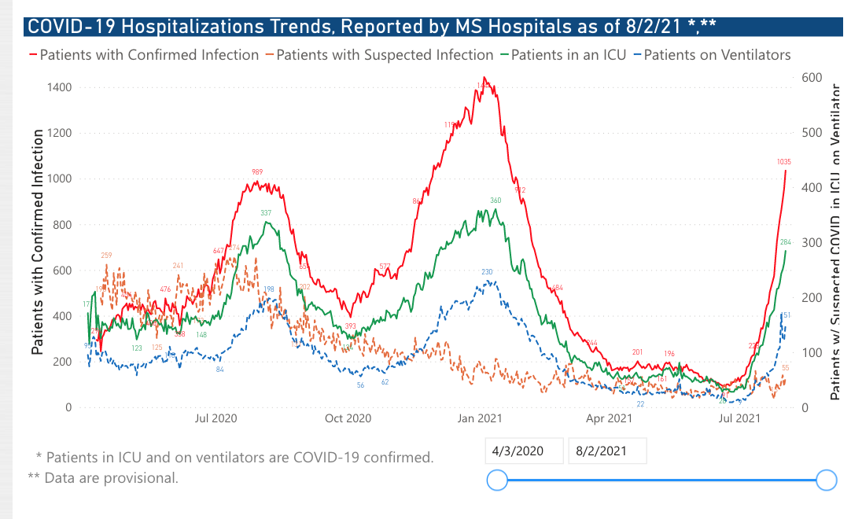
Update
4th COVID Wave
Primarily Delta Variant ( Originated in India)
New Cases : 2821 Cases (8/3/24) with 7 new deaths (August 1- 3rd) : 8 deaths last month
  ~ 7600 deaths total statewide with 352,891 cases ( Deaths 41.2 %: 55.2 % )
Hospitalizations increasing steadily: ICU beds scarce again, including PICU
Rankin County remains in top counties for COVID spread (along with Jackson Metro area)

Slide 3
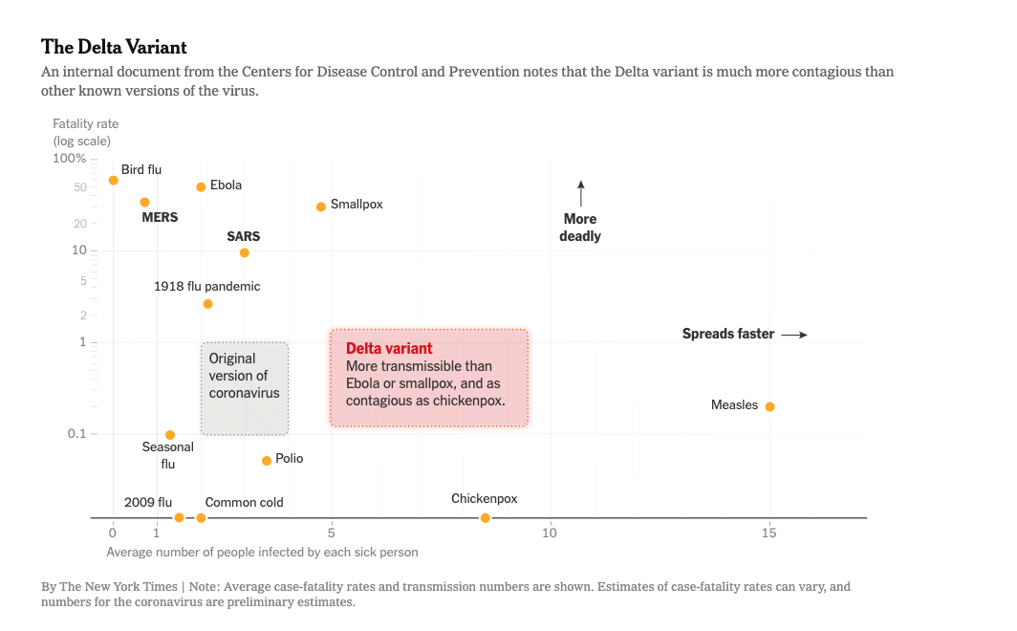
Notes on the Delta Variant
Most contagious of the variants so far ( Alpha to Kappa)
  Respiratory droplet spread
  An unvaccinated person who contracts the Delta variant is twice as likely to require hospitalization
  Can be spread by some of those who are vaccinated, if they contract COVID-19
  COVID-19 can be spread anywhere there are people with COVID-19 : So PROTECT YOURSELF & OTHERS; Be Vigilant
  Same precautions ( Social Distancing; Masks; Hand Hygiene), VACCINATION ) : More stringent
Symptoms tend to be more severe and progress more rapidly in Unvaccinated
  Symptoms : Fever, sore throat, runny nose/congestion, Shortness of breath, New Loss of smell /cough ,headache, muscle aches, fatigue, Nausea and vomiting ( Less cough, loss of smell than with Alpha variant is reported ,but we’re still learning about it and just like the other variants, some people won’t have any symptoms).
Affects primarily Unvaccinated* (93% in Mississippi) , with the majority < 50yrs ; Increasing cases in children and Adolescents

Slide 4
Vaccinations
Mississippi_ 35% Fully Vaccinated ( 50% US Average)
Mississippi ~ 70 % of older population is vaccinated compared to 80 % nationwide
Mississippi- 10 % of Kids < 18) are fully immunized and 17 % are at least partially immunized (Ranks #50/51)
Mississippi_ Vaccinations are increasing ( # 8 for increased vaccinations; Still below national average )
Pfizer and Moderna studies have indicated effectiveness against the Delta variant
Boosters are coming. MSDH recommends discussing with Provider, especially if immunosuppressed: Full Vaccine authorization is expected next month
Homebound Vaccinations are available: COVIDHomebound@msdh.ms.gov
Vaccines are available in local health departments, physician offices, Community Health Centers, UMMC clinics,Pharmacies : 1-800-232-0233 Vaccine.Gov and MSDH website.

Slide 5
Updated MSDH Guidance –July 28, 2021
Get a COVID-19 vaccination if you are eligible.
MSDH recommends everyone (including those who are fully vaccinated) wear a mask in public indoor settings.
If you test positive for COVID-19,* even if fully vaccinated, you should isolate for at least 10 days from the beginning of your symptoms or from your test date if you have no symptoms.
If you are exposed to someone with COVID-19, you should get tested 3-5 days following exposure. If you are not fully vaccinated, you should quarantine for at least 10 days after exposure (fully vaccinated persons do not have to quarantine after exposure, but should get tested).
• If you are 65 years of age or older, you should avoid all indoor mass gatherings, even if you have been vaccinated.
If you have a chronic medical condition, you should avoid all indoor mass gatherings, even if you have been vaccinated.
Mask Indoors in public setting regardless of Vaccine Status
________________________________________________________________________________________________________________________________________
Please note that Treatment with Monoclonal Antibodies is Available: Ask for it ! ( MSDH Centers of Excellence)
* PCR tests are more accurate as they test for molecular structure of antigens and actual infections( take slightly longer for results); Antibody tests only confirm that you have had an infection.

Slide 6
Specific MSDH Guidance
Review complete School Guidance as Students return to school:https://msdh.ms.gov/msdhsite/_static/resources/14912.pdf
Review Guidance for College Students :https://msdh.ms.gov/msdhsite/_static/resources/10472.pdf
Workplsce Guidance: https://msdh.ms.gov/msdhsite/_static/resources/15099.pdf
Note: Guidance will change as COVID-19 Situations change

Slide 7
Bottomline Recommendations
Vaccinate if over 12 years
Socially Distance
Mask Up !! ( Surgical Masks,KN95, Cloth Masks with Filters or Double Masking have been found to be effective)
Practice Hand Hygiene ( Wash hands with soap and water for 20 seconds: Use Hand Sanitizer if you can’t wash)
Make Sure mask covers Mouth and Nose ; Keep hands away from face
Don’t forget the importance of Disinfection and Good Ventilation
Keep Up to date with guidelines : Visit reputable sites ___,gov ;.edu ; WebMD, etc: Credible sites from medical organizations, news outlets will list the Author, purpose, date/frequency and author of updates: Check last Update to avoid outdated information)
Remember the Golden Rule

Slide 8
Major References
MSDH.ms.gov
CD.gov
AAP.org

